Slide 1
UTKALHACK 2.0
SOLAR POWERED SMART AGRICULTURE SYSTEM
PRESENTED BY:- TEAM AGROTECH
INSTITUTE NAME:- CHAIBASA ENGINEERING COLLEGE
TEAM LEADER :- PUJA KUMARI
TEAM MEMBER 1 :- AMAN PRAJAPATI
TEAM MEMBER 2 :- ANIKET KUMAR SAW

Slide 2
TECHNOLOGY USED
Rain Pipe
Solar Panel
Arduino Uno
Soil Moisture Sensor
Water Pump
DS3231 Real Time Clock Module

Slide 3
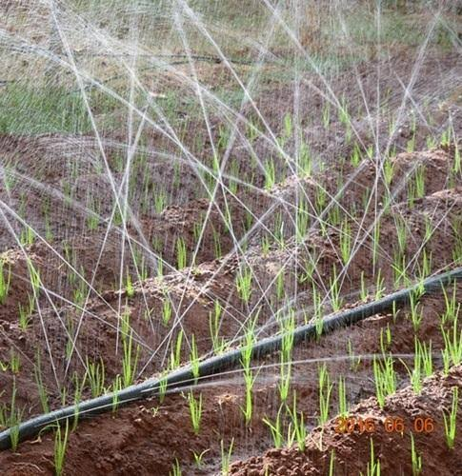
RAIN PIPE
It has Nano punch holes for sprinkling water.
It has range up to 10-15ft one side each at required minimal pressure.

Slide 4
DS3231 RTC MODULE
SOLAR PANEL
WATER TANK
RAIN PIPE
RELAY1
PUMP
MICROCONTROLLER
RELAY2
FERTILIZER TANK
FIELD
PUMP
RELAY3
SOLAR BATTERY
SOIL MOISTURE SENSOR
INVERTER
PESTICIDES TANK
PUMP

Slide 5
ADVANTAGES OF THIS SYSTEM:-
1. Fully Automatic System
2. Time Saving System
3. Cost effective

